Slide 1

Lawn Buddy
“The cutting hedge technology”
Assignment 3: Scrum: Planning & Execution
Enaas Ahmad, Gasser Ahmed, Hamnah Rizwan
BIT 5594
7/31/2022

Slide 2





Introduction
Project Scope Statement
For Lawn Buddy we developed an e-commerce website for our business, using the Scrum methodology. The website will include, at a minimum, a home page, about section, blog posts, support, career opportunities, business plan, and an e-commerce page with an Ecwid store. The site will also have a friendly user interface that is easy to navigate.
Roadmap
An overview of the planned timeline, milestones, and deliverables of the final project
Sprint
Description of what took place for each sprint, and a comparison between Sprint 1 and Sprint 2
Scrum/Kanban board
Depicts the stages of the project including the Project backlog, MVP, and Sprint comparison
Standup Notes
Documentation during our standup meetings where we planned and adjusted tasks as needed
Retrospective Notes
Overview of how the project went, and improvements could be made for the future

Slide 3
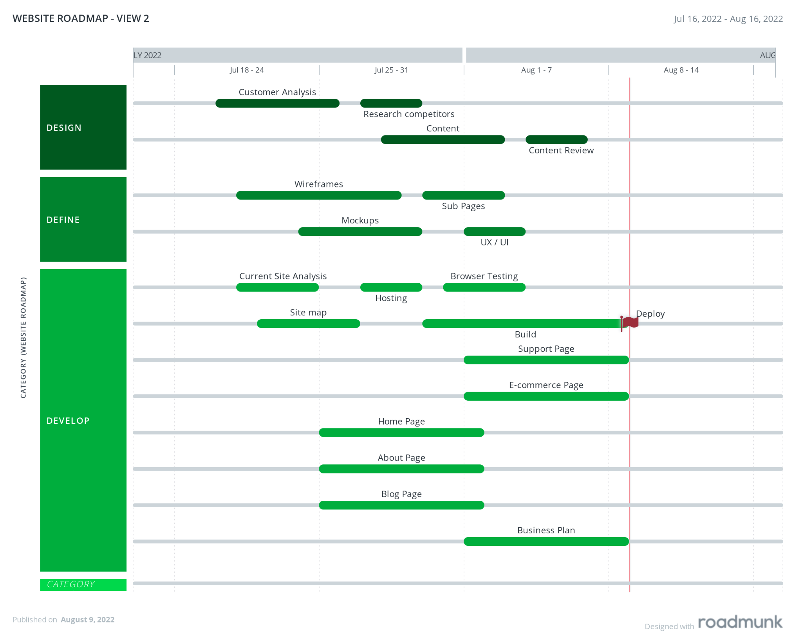
Scrum Roadmap
Notes:
Include high level features
Adjust dates accordingly

Slide 4
MVP vs Backlog
The MVP was selected by determining the success criteria for our project. We then considered the prioritization of the project’s features and the customer needs. For Lawn Buddy, we listed out the potential features and separated them into four categories to help determine which to prioritize in the MVP.
Debate
High Impact
Include in MVP
“Support” Page: Privacy policy
“Business Plan:” Product/service
“Business Plan:” Marketing plan
“Business Plan”: Operations
“Business Plan:” Financials
“E-commerce” Page: E-commerce app/plugin
“E-commerce” Page: Cart
“E-commerce” Page: Checkout
“Home” Page: Lawn Buddy Overview
“Home” Page: Sign up button
“Home” Page: How Lawn Buddy works
“About” Page: Mission & culture
“About” Page: The team
“Support” Page: FAQ
“Support” Page: Terms & conditions
“About” Page: Testimonials
“Blog” Page: News
Promos & Specials
Setup database
Low
Urgency
High
Urgency
“Career Opportunities:” Jobs Available
“Career Opportunities:” Benefits
“About Us” Page: Advisors
“About Us” Page: Partners
“Blog” Page: Gallery Page
“Blog” Page: Case Studies/client page
Contact Page
Customer confirmation page
Confirmation email
Setup payment merchant service
Profile/account page
Don’t Include In MVP
Low Impact
Revisit
Notes:
Match with Kanban board for features

Slide 5
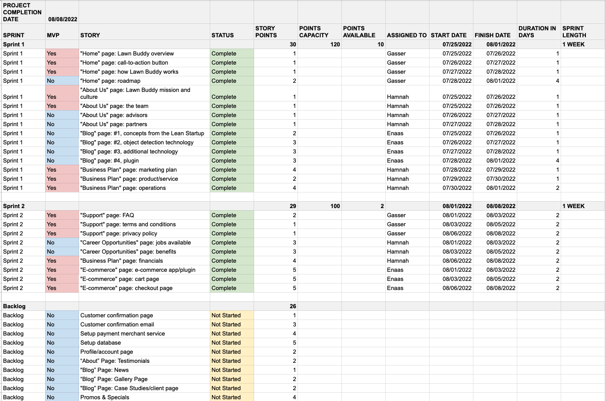
MVP vs Backlog
Notes:
Backlog Spreadsheet Link: https://docs.google.com/spreadsheets/d/18J4Ar8B82NslGVTDSySM2jdiz17-u7eK4tMNJfMAnn8/edit#gid=0

Slide 6
Estimation Basis
Story points: The story points used was a 1, 2, 3, 4, 5 sequence. The points were categorized as follows: 1 - Green = Very Easy, 2 - Yellow = Easy, 3 - Orange = Medium, 4 - Red = Hard, and 5 - Purple = Very Hard
Planned sprints: The sprints were determined by two main factors, which were the number of points for each story and and points capacity for each sprint. For example, some tasks were moved from Sprint 2 to Sprint 1, and vice versa, since one of the stories had higher points than the others. As a specific example, most of the business plan stories were moved from Sprint 2 to Sprint 1, since Sprint 2 had many more points than Sprint 1.
Identifying the Capacity: The capacity was identified by firstly determining the availability of each team member. For each member, time off was subtracted from Net Work Hours, and the results were multiplied by his/her availability to get the individual capacity. The individual capacities were then added to get the Team capacity in person hours, and divide by eight to get the capacity in person-days.
Sprint #1 Capacity = 120 (Enaas: 40, Gasser: 40, Hamnah: 40)
Sprint #2 Capacity = 100 (Enaas: 35, Gasser: 30, Hamnah: 35)
Notes:
Reword and add more details

Slide 7
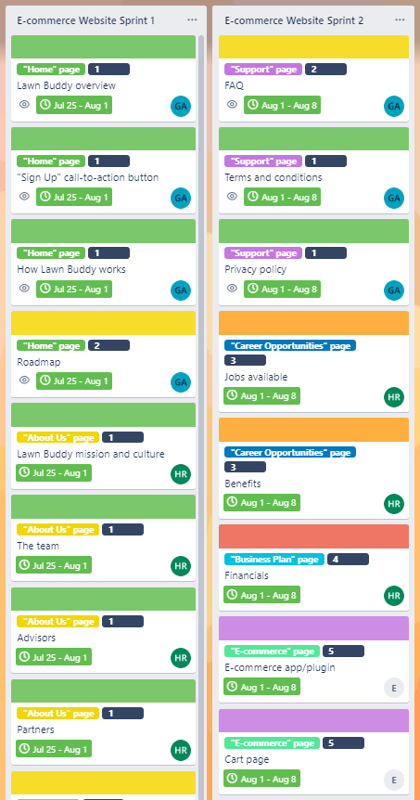
Timeline & Sprint 1 vs Sprint 2
Notes:
Backlog Spreadsheet Link: https://docs.google.com/spreadsheets/d/18J4Ar8B82NslGVTDSySM2jdiz17-u7eK4tMNJfMAnn8/edit#gid=0

Slide 8
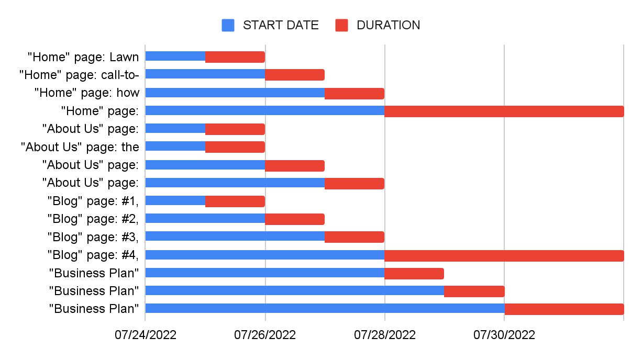
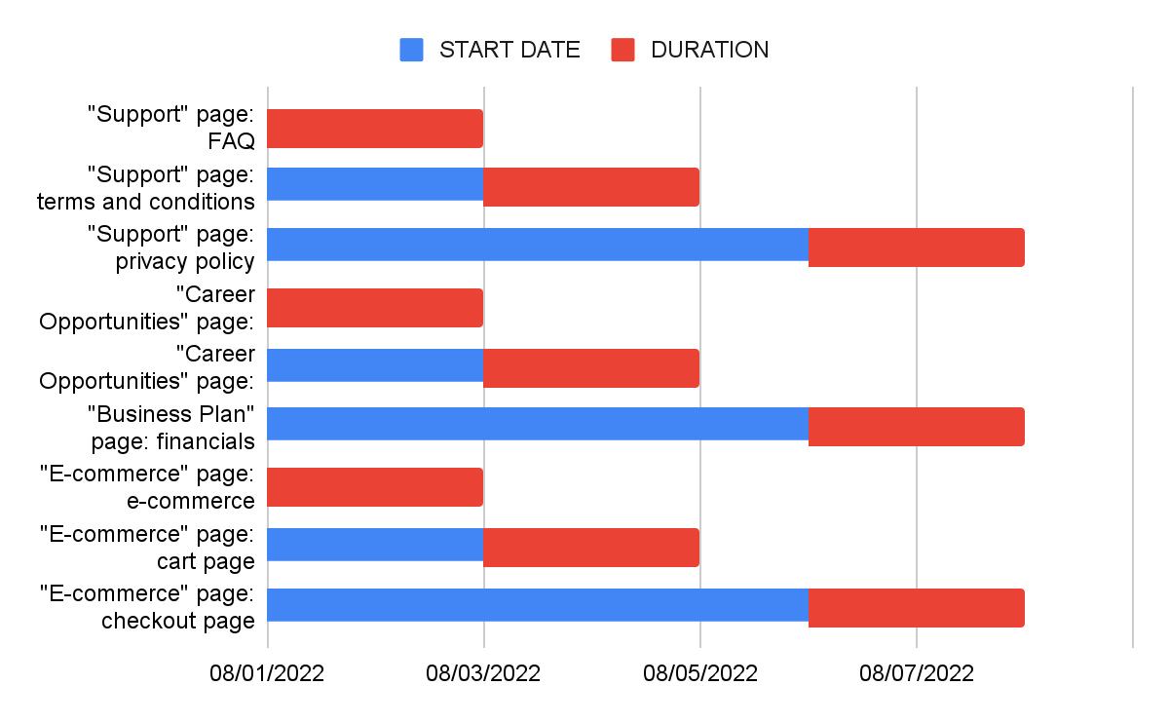
Sprint 1 vs Sprint 2
We decided on two factors to determine what the Sprints would consist of. These were the number of points for each story (30 for Sprint 1 and 29 for Sprint 2) and the points capacity (120 for Sprint 1 and 100 for Sprint 2) for each Sprint. For example, since one of the stories had higher points than the others, some tasks were moved from Sprint 2 to Sprint 1, and vice versa. Additionally, some of the business plan stories were moved from Sprint 2 to Sprint 1, since Sprint 2 had more points than Sprint 1.
Sprint 1
Sprint 2
Notes:
Simplified version of planned sprints (slide 6)

Slide 9
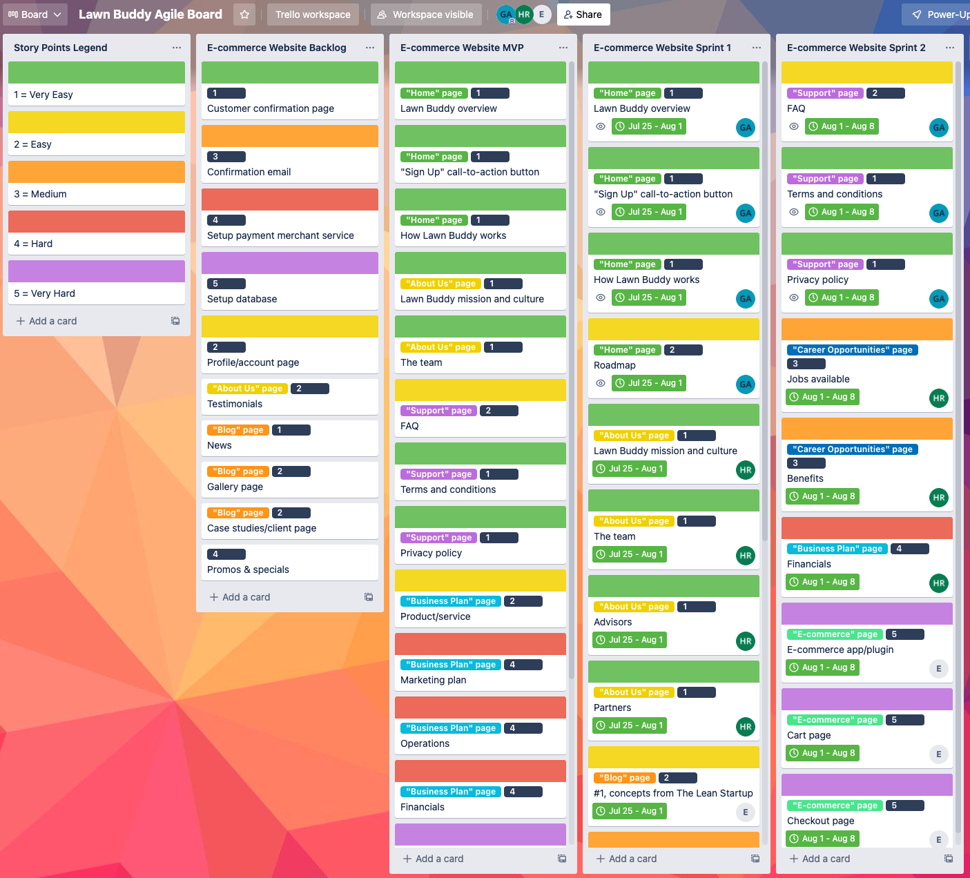
Scrum/Kanban board
Notes:
Trello Board Link: https://trello.com/b/MFcGKIqt/lawn-buddy-agile-board

Slide 10
Standup #1 Notes - 07/25/2022
Enaas
Gasser
Hamnah
Started a WordPress project (https://lawnbuddy.wordpress.com)
Planning to complete “Blog” page
Discussed meeting with the team for standup #2 on 08/01/2022
Started agile board on Trello and discussed user stories and story points with the team
Planning to finish the Trello agile board to include user stories, sprints, dates, and assignments.
Planning to finish “Home” page
Took standup notes
Planning to create a roadmap of high-level features for the website
Planning to present MVP versus the entire backlog/RTM
Planning to finish “About Us” page and most of the “Business Plan” page
Identified issues
Suggested Resolutions
What Application Lifecycle Management (ALM) tool should we use?
What sequence should we use to estimate story points?
Wix versus WordPress
How long should sprints be?
Decided to use Trello after comparing it Trello, Asana, and Jira
Agreed on using 1, 2, 3, 4, 5 sequence to estimate story points as follows: 1 - Green = Very Easy, 2 - Yellow = Easy, 3 - Orange = Medium, 4 - Red = Hard, and 5 - Purple = Very Hard
Decided to use WordPress after comparing its pros and cons to Wix
Agreed to have 1 week sprints

Slide 11
Standup #2 Notes - 08/01/2022
Enaas
Gasser
Hamnah
Took standup notes
Completed “Blog” page
Planning to finish “Support” page
Planning to create an Ecwid store (Ecwid Instant Site) and link page to the site
Finished the Trello agile board to include user stories, sprints, dates, and assignments
Finished “Home” page
Planning to finish “E-commerce” page
Created a roadmap of high-level features for the website
Presented MVP versus the entire backlog/RTM
Finished “About Us” page and most of the “Business Plan” page
Planning to finish “Career Opportunities” page and the rest of “Business Plan” page
Identified issues
Suggested Resolutions
WordPress is not showing the website pages
Ecwid store didn’t have definitive options for services
Team member emergency causing partial unavailability
The overview pages are published but not the “pages”
Use an ecommerce online store that is geared toward services rather than products. Added sample services, but they did not complete the criteria of the Lawn Buddy formula.
Reassign user stories to be able to meet our sprint deadline

Slide 12



Retrospective Notes - 08/08/2022
What went well
What didn’t go well
Lessons Learned
Great communication and input from the team
The team dynamic as we resolved issues was excellent
Effective standup meetings
Good planning gave us a head start on developing the website
The website demo went well
All user stories were delivered on time
We had to redo the Trello agile board to represent the e-commerce website user stories instead of the actual Lawn Buddy app user stories
Stories took longer to implement than we expected
Had a couple instances of a team member starting work on a story without assigning it to themselves, and then someone else started working on it too
Make sure to carefully read and understand the requirements before starting any work
Backlog maintenance
Improve user stories to have more details
Make better estimates of story points and dates
Frequent saving of the website to ensure that no progress is lost

Slide 13
Appendix
https://icons8.com/
https://www.atlassian.com/team-playbook/plays/retrospective
https://www.smartsheet.com/content/agile-sprint-scrum-capacity-templates
https://roadmunk.com/roadmap-templates/scrum-roadmap#:~:text=What%20is%20a%20scrum%20roadmap,tackled%20during%20each%20sprint%20cycle.
https://medium.com/@ClrMobile/planning-a-minimum-viable-product-a-step-by-step-guide-6f387d657870

